Slide 1
Chapter 14 JavaFX Basics

Slide 2
Motivations
JavaFX is a new framework for developing Java GUI programs.
Graphical User Interface (GUI)
  provides user-friendly human interaction
The JavaFX API (Application Programming
Interface) is an excellent example of how the object-oriented principle is applied.

Slide 3
Motivations
This chapter serves two purposes.
  First, it presents the basics of JavaFX programming.
  Second, it uses JavaFX to demonstrate OOP.
Specifically, this chapter introduces the framework of JavaFX and discusses JavaFX GUI components and their relationships.

Slide 4
JavaFX vs Swing and AWT
Swing and AWT are replaced by the JavaFX platform for developing rich Internet applications.
When Java was introduced, the GUI classes were bundled in a library known as the Abstract Windows Toolkit (AWT).
  AWT is fine for developing simple graphical user interfaces, but not for developing comprehensive GUI projects.
  In addition, AWT is prone to platform-specific bugs.
The AWT user-interface components were replaced by a more robust, versatile, and flexible library known as Swing components.
  Swing components are painted directly on canvases using Java code.
  Swing components depend less on the target platform and use less of the native GUI resource.
With the release of Java 8, Swing is replaced by a completely new GUI platform known as JavaFX.

Slide 5
Basic Structure of JavaFX
Application
  The abstract javafx.application.Application class defines the essential framework for writing JavaFX programs.
  public class MyJavaFX extends Application

Slide 6
Basic Structure of JavaFX
The launch method is a static method defined in the Application class for launching a stand-alone JavaFX application.
The main method is not needed if you run the program from the command line.
It may be needed to launch a JavaFX program from an IDE with a limited JavaFX support.
When you run a JavaFX application without a main method, JVM automatically invokes the launch method to run the application.
public static void main(String[] args) {
Application.launch(args);
}

Slide 7
Basic Structure of JavaFX
The main class overrides the start method defined in javafx.application.Application.
After a JavaFX application is launched, the JVM constructs an instance of the class using its no-arg constructor and invokes its start method.
The start method normally places UI controls in a scene and displays the scene in a stage.
@Override // Override the start method in the Application class
public void start(Stage primaryStage) {
…
}

Slide 8
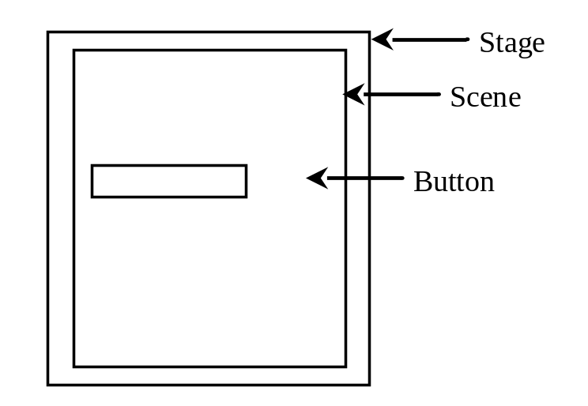
Basic Structure of JavaFX
Application
Override the start(Stage) method
Stage, Scene, and Nodes
  javafx.stage.Stage is the top level JavaFX container. The primary Stage is constructed by the platform.
  javafx.scene.Scene class is the container for all content in a scene graph.
  javafx.scene.Node is the base class for scene graph nodes.
MyJavaFX
Run
MultipleStageDemo
Run

Slide 9
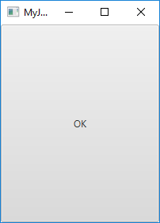
import javafx.application.Application;
import javafx.stage.Stage;
import javafx.scene.Scene;
import javafx.scene.control.Button;
public class MyJavaFX extends Application {
@Override // Override the start method in the Application class
public void start(Stage primaryStage) {
// Create a button and place it in the scene
Button btOK = new Button("OK");
Scene scene = new Scene(btOK, 200, 250);
primaryStage.setTitle("MyJavaFX"); // Set the stage title
primaryStage.setScene(scene); // Place the scene in the stage
primaryStage.show(); // Display the stage
}
/**
* The main method is only needed for the IDE with limited
* JavaFX support. Not needed for running from the command line.
*/
public static void main(String[] args) {
launch(args);
}
}

Slide 10
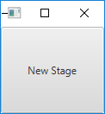
import javafx.application.Application;
import javafx.scene.Scene;
import javafx.scene.control.Button;
import javafx.stage.Stage;
public class MultipleStageDemo extends Application {
@Override // Override the start method in the Application class
public void start(Stage primaryStage) {
// Create a scene and place a button in the scene
Scene scene = new Scene(new Button("OK"), 200, 250);
primaryStage.setTitle("MyJavaFX"); // Set the stage title
primaryStage.setScene(scene); // Place the scene in the stage
primaryStage.show(); // Display the stage
Stage stage = new Stage(); // Create a new stage
stage.setTitle("Second Stage"); // Set the stage title
// Set a scene with a button in the stage
stage.setScene(new Scene(new Button("New Stage"), 100, 100));
stage.show(); // Display the stage
}
/**
* The main method is only needed for the IDE with limited
* JavaFX support. Not needed for running from the command line.
*/
public static void main(String[] args) {
launch(args);
}
}

Slide 11
☑ Check Point
How do you define a JavaFX main class? What is the signature of the start method? What is a stage? What is a primary stage? Is a primary stage automatically created? How do you display a stage? Can you prevent the user from resizing the stage? Can you replace Application.launch(args) by launch(args)?
<--- ANSWER --->
You define a JavaFX main class by extending the Application class.
The signature of the start method is public void start(Stage primaryStage)
A stage is a window to holding a scene. An application may have multiple stages.
The primary stage is automatically created when a JavaFX program is launched. To display a stage, invoke its show() method.
You can prevent the user from resizing the stage by invoking stage.setResizable(false).
You can replace Application.launch(args) by launch(args), because the JavaFX main class is a subtype of Application.

Slide 12
Panes, UI Controls, and Shapes
Panes, UI controls, and shapes are subtypes of Node.
A node is a visual component such as a shape, an image view, a UI control, or a pane.
A shape refers to a text, line, circle, ellipse, rectangle, arc, polygon, polyline, etc.
A UI control refers to a label, button, check box, radio button, text field, text area, etc.
Panes are container classes for automatically laying out the nodes in a desired location and size.

Slide 13
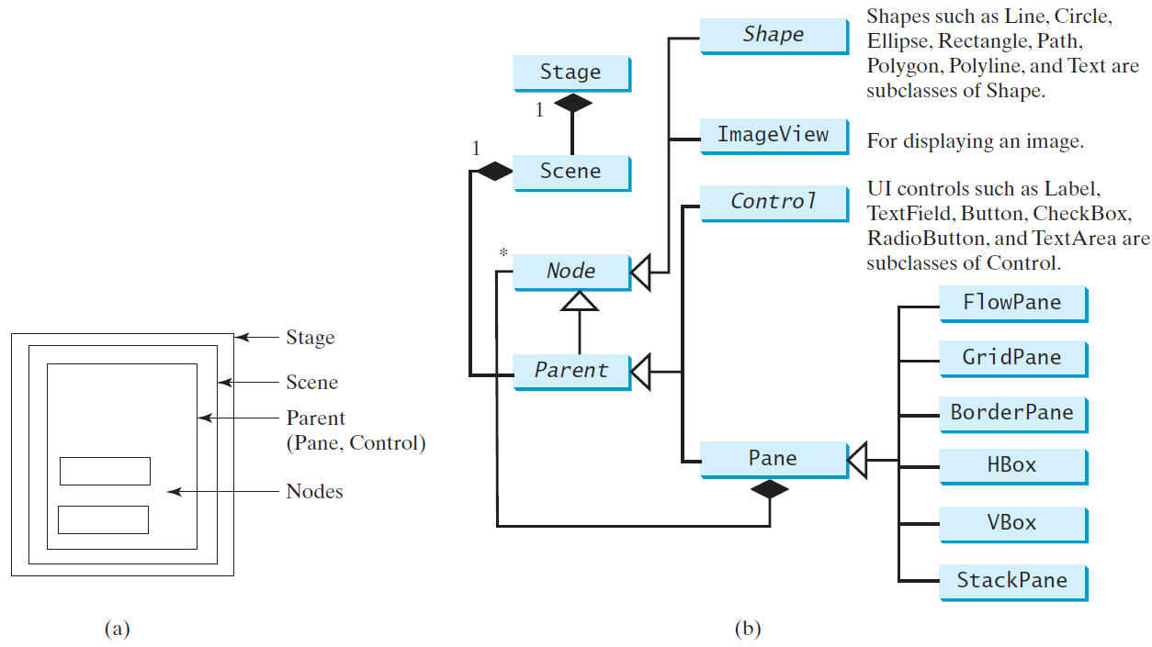
Panes, UI Controls, and Shapes
ButtonInPane
Run

Slide 14

import javafx.application.Application;
import javafx.stage.Stage;
import javafx.scene.Scene;
import javafx.scene.layout.StackPane;
import javafx.scene.control.Button;
public class ButtonInPane extends Application {
@Override // Override the start method in the Application class
public void start(Stage primaryStage) {
// Create a scene and place a button in the scene
StackPane pane = new StackPane();
pane.getChildren().add(new Button("OK"));
Scene scene = new Scene(pane, 200, 50);
primaryStage.setTitle("Button in a pane"); // Set the stage title
primaryStage.setScene(scene); // Place the scene in the stage
primaryStage.show(); // Display the stage
}
public static void main(String[] args) {
launch(args);
}
}

Slide 15
Panes
The program creates a StackPane and adds a
button as a child of the pane.
The getChildren() method returns an instance of
javafx.collections.ObservableList.
ObservableList behaves very much like an
ArrayList for storing a collection of elements.
Invoking add(e) adds an element to the list.
The StackPane places the nodes in the center of
the pane on top of each other.

Slide 16
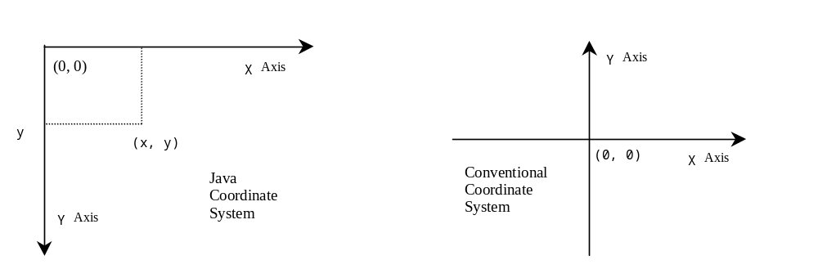
Display a Shape
This example displays a circle in the center of the pane.
The Java coordinate system is measured in pixels, with (0, 0) at its upper-left corner.
ShowCircle
Run

Slide 17
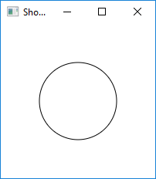
import javafx.application.Application;
import javafx.stage.Stage;
import javafx.scene.Scene;
import javafx.scene.layout.Pane;
import javafx.scene.shape.Circle;
import javafx.scene.paint.Color;
public class ShowCircle extends Application {
@Override // Override the start method in the Application class
public void start(Stage primaryStage) {
// Create a circle and set its properties
Circle circle = new Circle();
circle.setCenterX(100);
circle.setCenterY(100);
circle.setRadius(50);
circle.setStroke(Color.BLACK);
circle.setFill(Color.WHITE);
// Create a pane to hold the circle
Pane pane = new Pane();
pane.getChildren().add(circle);
// Create a scene and place it in the stage
Scene scene = new Scene(pane, 200, 200);
primaryStage.setTitle("ShowCircle"); // Set the stage title
primaryStage.setScene(scene); // Place the scene in the stage
primaryStage.show(); // Display the stage
}
/**
* The main method is only needed for the IDE with limited
* JavaFX support. Not needed for running from the command line.
*/
public static void main(String[] args) {
launch(args);
}
}

Slide 18
☑ Check Point
What is a pane? What is a node? How do you place a node in a pane? Can you directly place a Shape or an ImageView into a Scene? Can you directly place a Control or a Pane into a Scene?
<--- ANSWER --->
A pane is used to hold and organize nodes.
A node is a visual component that can be displayed.
You can place a node into a pane using the pane.getChildren().add(node).
You cannot directly place a Shape or an ImageView into a scene.
You can directly place a Control or a Pane into a scene when constructing a Scene using new Scene(Parent, width, height) or new Scene(Parent). Parent is the superclass for Control and Pane.

Slide 19
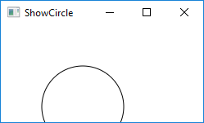
Binding Properties
JavaFX introduces a new concept called binding property that enables a target object to be bound to a source object.
  If the value in the source object changes, the target property is also changed automatically.
  The target object is simply called a binding object or a binding property.
  The source object is called a bindable object or observable object.
Resizing the window in the previous example would cover
the object:
Example: target.bind(source);

Slide 20
Binding Properties
In order to display the circle centered as the window resizes, the x- and y-coordinates of the circle center need to be reset to the center of the pane.
This can be done by binding the centerX with pane’s width/2 and centerY with pane’s height/2.
ShowCircleCentered
Run

Slide 21
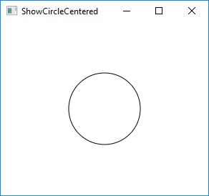
import javafx.application.Application;
import javafx.stage.Stage;
import javafx.scene.Scene;
import javafx.scene.layout.Pane;
import javafx.scene.shape.Circle;
import javafx.scene.paint.Color;
public class ShowCircleCentered extends Application {
@Override // Override the start method in the Application class
public void start(Stage primaryStage) {
// Create a pane to hold the circle
Pane pane = new Pane();
// Create a circle and set its properties
Circle circle = new Circle();
circle.centerXProperty().bind(pane.widthProperty().divide(2));
circle.centerYProperty().bind(pane.heightProperty().divide(2));
circle.setRadius(50);
circle.setStroke(Color.BLACK);
circle.setFill(Color.WHITE);
pane.getChildren().add(circle); // Add circle to the pane
// Create a scene and place it in the stage
Scene scene = new Scene(pane, 200, 200);
primaryStage.setTitle("ShowCircleCentered"); // Set the stage title
primaryStage.setScene(scene); // Place the scene in the stage
primaryStage.show(); // Display the stage
}
/**
* The main method is only needed for the IDE with limited
* JavaFX support. Not needed for running from the command line.
*/
public static void main(String[] args) {
launch(args);
}
}
Notes:
- The bind method is defined in the javafx.beans.property.Property interface.
- A binding property is an instance of javafx.beans.property.Property.
- A source object is an instance of the javafx.beans.value.ObservableValue interface.
- An ObservableValue is an entity that wraps a value and allows to observe the value for changes.

Slide 22
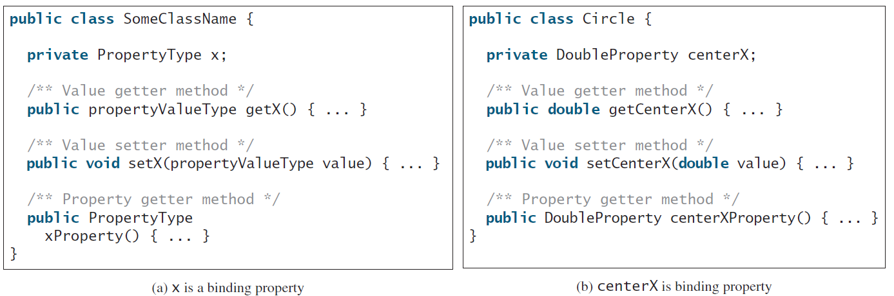
Binding Property: getter, setter, and property getter
(a) shows the convention for defining a binding property in a class and
(b) shows a concrete example in which centerX is a binding property of the type DoubleProperty.

Slide 23
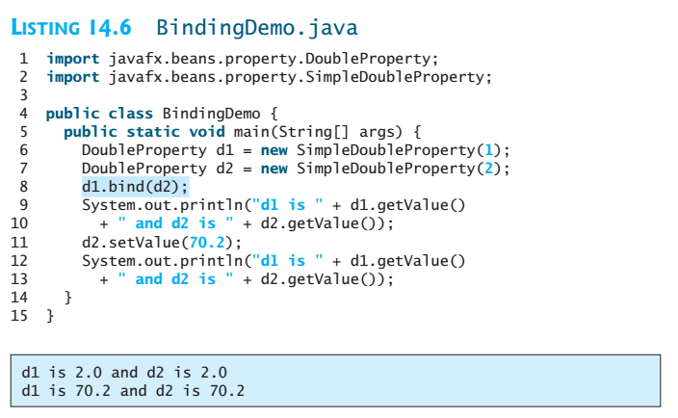
Unidirectional Binding
Bidirectional binding: If the target and source are both binding properties and observable properties, they can be bound bidirectionally using the bindBidirectional method.
See BidirectionalBindingDemo.java

Slide 24
Common Properties and Methods for Nodes
The abstract Node class defines many properties and methods that are common to all nodes.
Two common properties:
  style: set a JavaFX CSS style
  rotate: Rotate a node

Slide 25
Common Properties and Methods for Nodes
JavaFX style properties are similar to cascading style sheets (CSS) used to specify the styles for HTML elements in a Web page.
So, the style properties in JavaFX are called JavaFX CSS.
In JavaFX, a style property is defined with a prefix
-fx-
Each node has its own style properties.
    You can find these properties from
    http://docs.oracle.com/javafx/2/api/javafx/scene/doc-files/cssref.html

Slide 26
Common Properties and Methods for Nodes
The syntax for setting a style is styleName:value.
Multiple style properties for a node can be set
together separated by semicolon (;).
For example, the following statement
circle.setStyle("-fx-stroke: black; -fx-fill: red;");
sets two JavaFX CSS properties for a circle.
rotate: Rotate a node
NodeStyleRotateDemo
Run

Slide 27
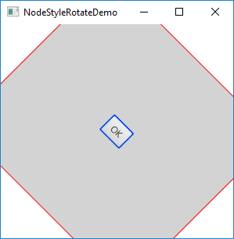
import javafx.application.Application;
import javafx.stage.Stage;
import javafx.scene.Scene;
import javafx.scene.layout.StackPane;
import javafx.scene.control.Button;
public class NodeStyleRotateDemo extends Application {
@Override
public void start(Stage primaryStage) {
StackPane pane = new StackPane();
Button btOK = new Button("OK");
btOK.setStyle("-fx-border-color: blue;");
pane.getChildren().add(btOK);
pane.setRotate(45);
pane.setStyle("-fx-border-color: red; -fx-background-color: lightgray;");
Scene scene = new Scene(pane, 200, 250);
primaryStage.setTitle("NodeStyleRotateDemo"); // Set the stage title
primaryStage.setScene(scene); // Place the scene in the stage
primaryStage.show(); // Display the stage
}
/**
* The main method is only needed for the IDE with limited
* JavaFX support. Not needed for running from the command line.
*/
public static void main(String[] args) {
launch(args);
}
}
Notes:
- The rotate on a pane causes all its containing nodes rotated too.

Slide 28
public class NodeStyleRotateDemo extends Application {
@Override
public void start(Stage primaryStage) {
StackPane pane = new StackPane();
…
}
/* The StackPane layout pane places all of the nodes within
a single stack with each new node added on top of the
previous node. This layout model provides an easy way to
overlay text on a shape or image and to overlap common
shapes to create a complex shape. */

Slide 29
☑ Check Point
How do you set a style of a node with border color red? Modify the code to set the text color for the button to red.
<--- ANSWER --->
node.setStyle("-fx-border: red");
text.setStyle("-fx-fill: red");

Slide 30
☑ Check Point
Can you rotate a pane, a text, or a button? Modify the code to rotate the button 15 degrees counterclockwise? How do you test if a point is inside a node? How do you scale up or down a node?
<--- ANSWER --->
Yes.
button.setRotate(-15);
node.contains(x, y);
node.setScaleX(2.0); // Scale x-coordinates up
node.setScaleX(0.2); // Scale x-coordinates down

Slide 31
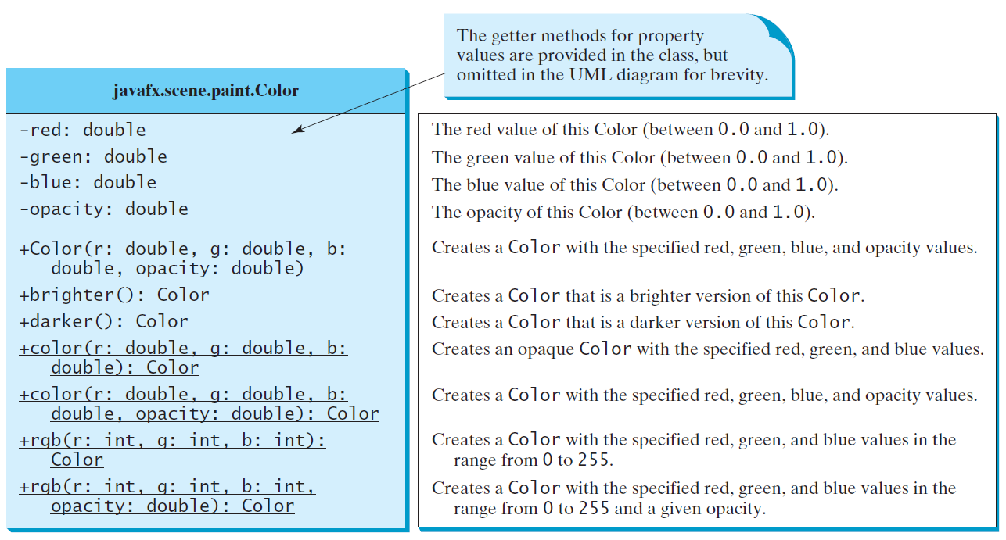
Helper Classes: The Color Class

Slide 32
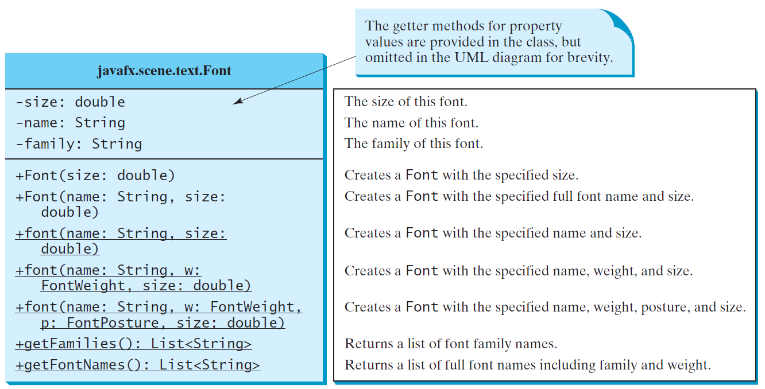
Helper Classes: The Font Class
FontDemo
Run

Slide 33
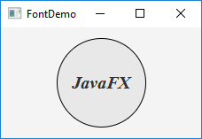
public class FontDemo extends Application {
@Override // Override the start method in the Application class
public void start(Stage primaryStage) {
// Create a pane to hold the circle
Pane pane = new StackPane();
// Create a circle and set its properties
Circle circle = new Circle();
circle.setRadius(50);
circle.setStroke(Color.BLACK);
circle.setFill(new Color(0.5, 0.5, 0.5, 0.1));
pane.getChildren().add(circle); // Add circle to the pane
// Create a label and set its properties
Label label = new Label("JavaFX");
label.setFont(Font.font("Times New Roman", FontWeight.BOLD, FontPosture.ITALIC, 20));
pane.getChildren().add(label);
// Create a scene and place it in the stage
Scene scene = new Scene(pane);
primaryStage.setTitle("FontDemo"); // Set the stage title
primaryStage.setScene(scene); // Place the scene in the stage
primaryStage.show(); // Display the stage
}
/**
* The main method is only needed for the IDE with limited
* JavaFX support. Not needed for running from the command line.
*/
public static void main(String[] args) {
launch(args);
}
}

Slide 34
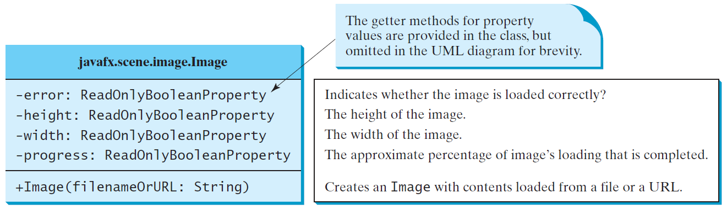
The Image Class

Slide 35
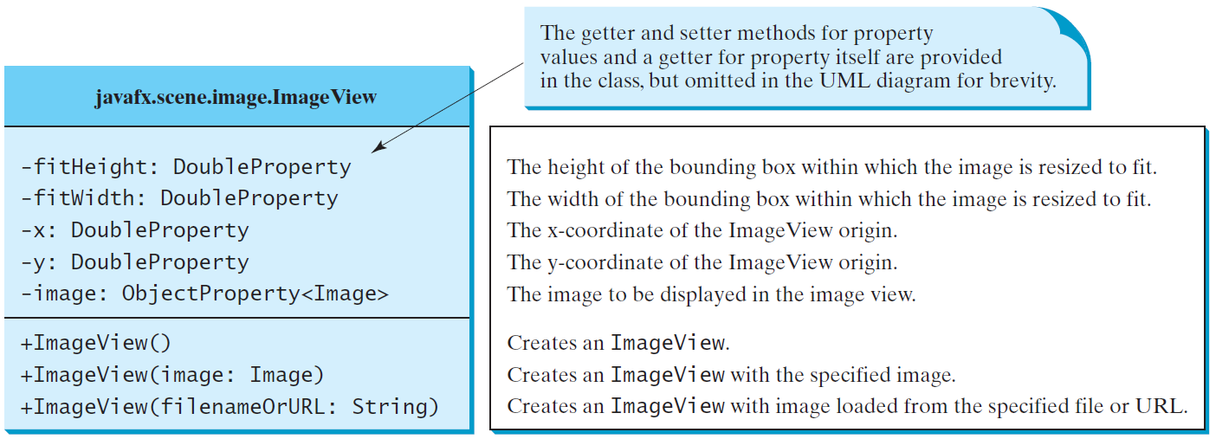
The ImageView Class
ShowImage
Run

Slide 36
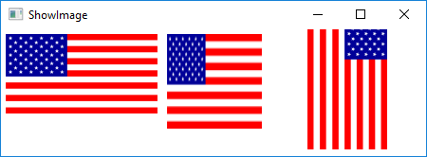
import javafx.application.Application;
import javafx.stage.Stage;
import javafx.scene.Scene;
import javafx.scene.layout.Pane;
import javafx.scene.layout.HBox;
import javafx.scene.image.Image;
import javafx.scene.image.ImageView;
import javafx.geometry.Insets;
public class ShowImage extends Application {
@Override
public void start(Stage primaryStage) {
// Create a pane to hold the image views
Pane pane = new HBox(10);
pane.setPadding(new Insets(5, 5, 5, 5));
Image image = new Image("image/us.gif");
pane.getChildren().add(new ImageView(image));
ImageView imageView2 = new ImageView(image);
imageView2.setFitHeight(100);
imageView2.setFitWidth(100);
pane.getChildren().add(imageView2);
ImageView imageView3 = new ImageView(image);
imageView3.setRotate(90);
pane.getChildren().add(imageView3);
Scene scene = new Scene(pane);
primaryStage.setTitle("ShowImage");
primaryStage.setScene(scene);
primaryStage.show();
}
public static void main(String[] args) {
launch(args);
}
}

Slide 37
☑ Check Point
Can you set an Image to multiple ImageView? Can you display the same ImageView multiple times?
<--- ANSWER --->
You can set an Image to multiple ImageView, but you cannot display one ImageView multiple times.

Slide 38
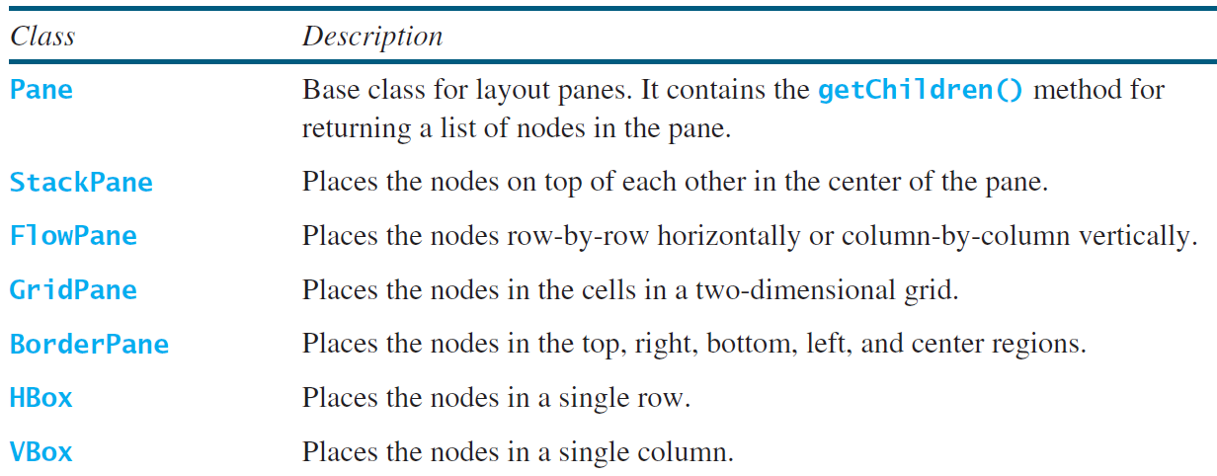
Layout Panes
JavaFX provides many types of panes for organizing nodes in a container.

Slide 39
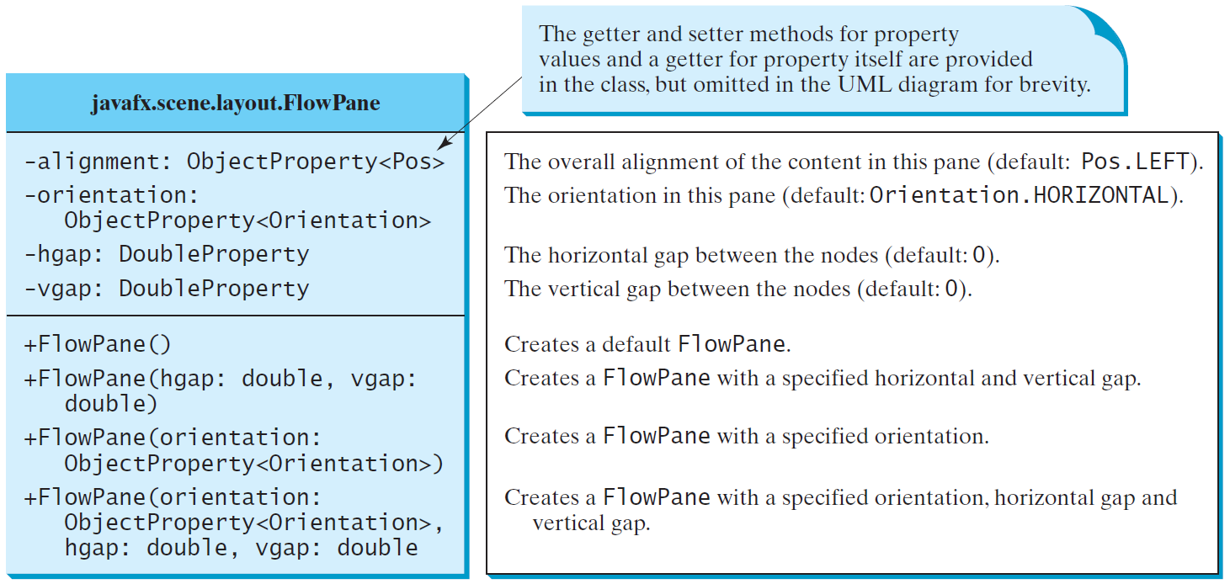
FlowPane
Places the nodes row-by-row horizontally
or column-by-column vertically.

Slide 40
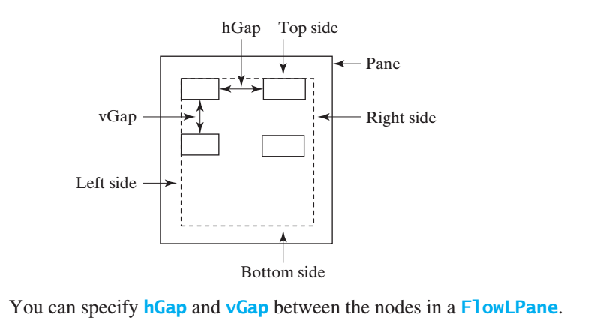
FlowPane
ShowFlowPane
Run

Slide 41
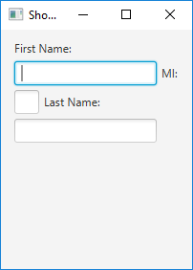

import javafx.application.Application;
import javafx.stage.Stage;
import javafx.scene.Scene;
import javafx.scene.layout.FlowPane;
import javafx.scene.control.Label;
import javafx.scene.control.TextField;
import javafx.geometry.Insets;
public class ShowFlowPane extends Application {
@Override
public void start(Stage primaryStage) {
FlowPane pane = new FlowPane();
pane.setPadding(new Insets(11, 12, 13, 14));
pane.setHgap(5);
pane.setVgap(5);
// Place nodes in the pane
pane.getChildren().addAll(new Label("First Name:"),
new TextField(), new Label("MI:"));
TextField tfMi = new TextField();
tfMi.setPrefColumnCount(1);
pane.getChildren().addAll(tfMi, new Label("Last Name:"),
new TextField());
// Create a scene and place it in the stage
Scene scene = new Scene(pane, 210, 150);
primaryStage.setTitle("ShowFlowPane");
primaryStage.setScene(scene); // Place the scene in the stage
primaryStage.show(); // Display the stage
}
public static void main(String[] args) {
launch(args);
}
}
Notes:
- Note that if you resize the window, the nodes are automatically rearranged to fit in the pane.

Slide 42
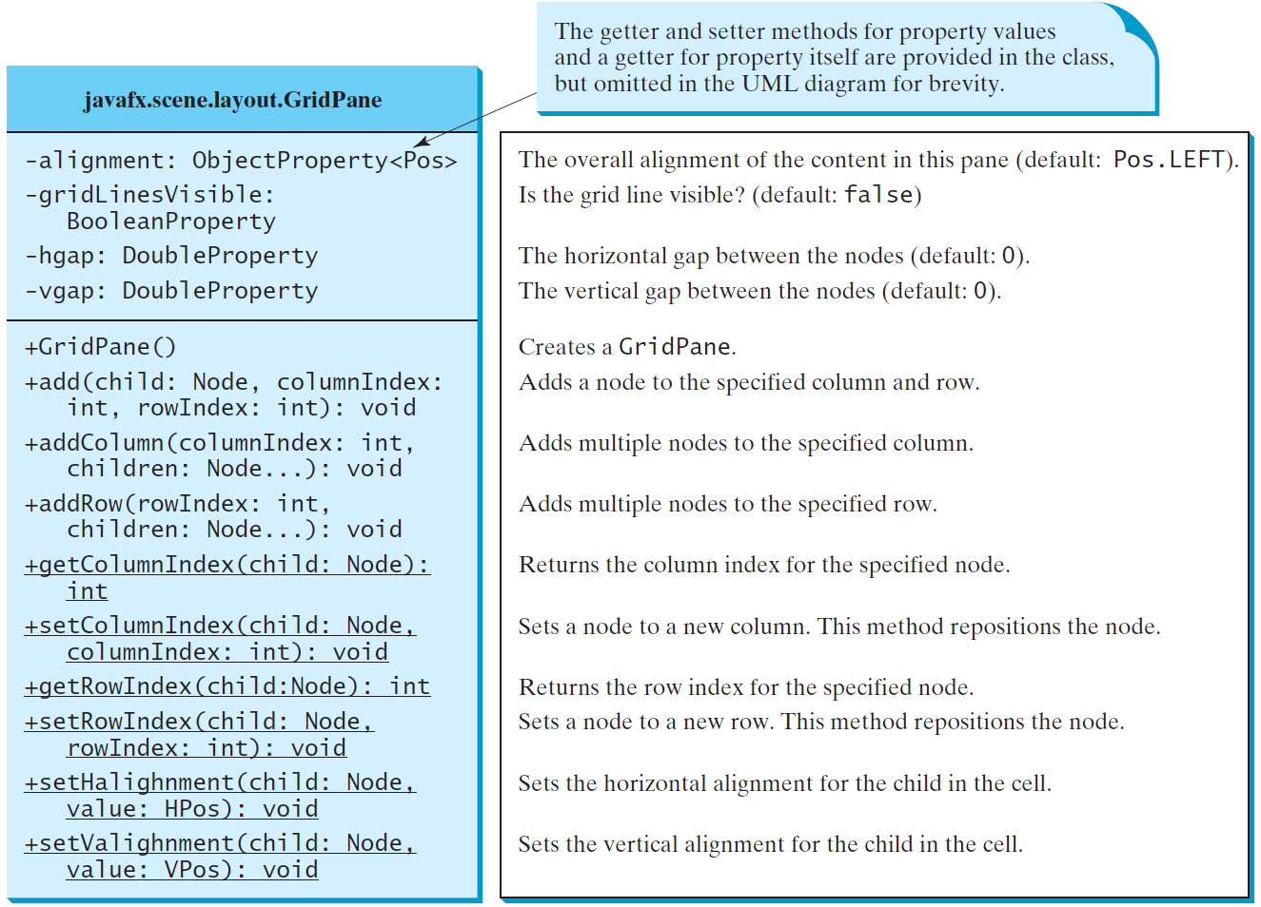
GridPane
Places the nodes in the cells
in a two-dimensional grid
ShowGridPane
Run

Slide 43
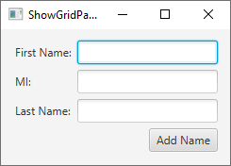
import javafx.application.Application;
import javafx.stage.Stage;
import javafx.scene.Scene;
import javafx.scene.layout.GridPane;
import javafx.scene.control.*;
import javafx.geometry.*;
public class ShowGridPane extends Application {
@Override
public void start(Stage primaryStage) {
// Create a pane and set its properties
GridPane pane = new GridPane();
pane.setAlignment(Pos.CENTER);
pane.setPadding(new Insets(11.5, 12.5, 13.5, 14.5));
pane.setHgap(5.5);
pane.setVgap(5.5);
// Place nodes in the pane at positions column,row
pane.add(new Label("First Name:"), 0, 0);
pane.add(new TextField(), 1, 0);
pane.add(new Label("MI:"), 0, 1);
pane.add(new TextField(), 1, 1);
pane.add(new Label("Last Name:"), 0, 2);
pane.add(new TextField(), 1, 2);
Button btAdd = new Button("Add Name");
pane.add(btAdd, 1, 3);
GridPane.setHalignment(btAdd, HPos.RIGHT);
// Create a scene and place it in the stage
Scene scene = new Scene(pane);
primaryStage.setTitle("ShowGridPane");
primaryStage.setScene(scene); primaryStage.show(); }
…
}

Slide 44
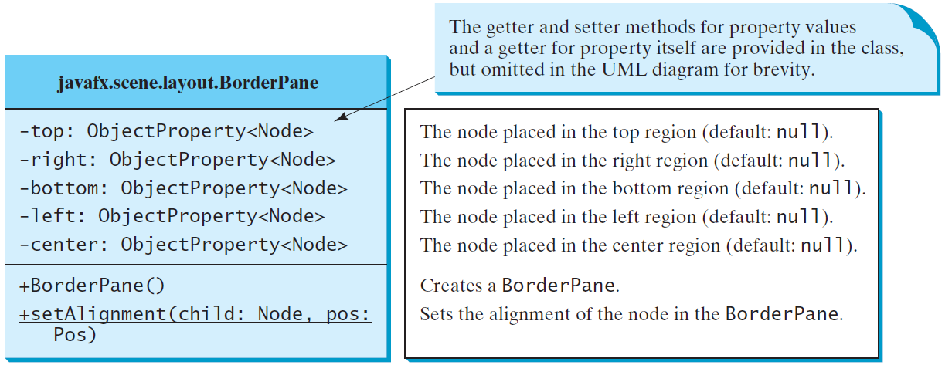
BorderPane
Places the nodes in the top, right, bottom,
left, and center regions.
ShowBorderPane
Run

Slide 45
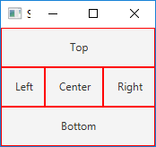
import javafx.application.Application;
import javafx.stage.Stage;
import javafx.scene.Scene;
import javafx.scene.layout.BorderPane;
import javafx.scene.layout.StackPane;
import javafx.scene.control.Label;
import javafx.geometry.Insets;
public class ShowBorderPane extends Application {
@Override
public void start(Stage primaryStage) {
BorderPane pane = new BorderPane();
pane.setTop(new CustomPane("Top"));
pane.setRight(new CustomPane("Right"));
pane.setBottom(new CustomPane("Bottom"));
pane.setLeft(new CustomPane("Left"));
pane.setCenter(new CustomPane("Center"));
Scene scene = new Scene(pane);
primaryStage.setTitle("ShowBorderPane"); // Set the stage title
primaryStage.setScene(scene); primaryStage.show();
}
/* main method defined here */
}
class CustomPane extends StackPane {
public CustomPane(String title) {
getChildren().add(new Label(title));
setStyle("-fx-border-color: red");
setPadding(new Insets(11.5, 12.5, 13.5, 14.5));
}}

Slide 46
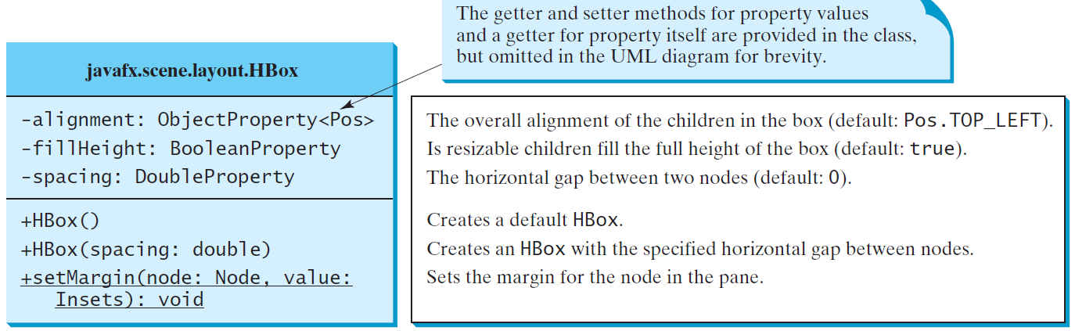
HBox
Places the nodes in a single row.

Slide 47
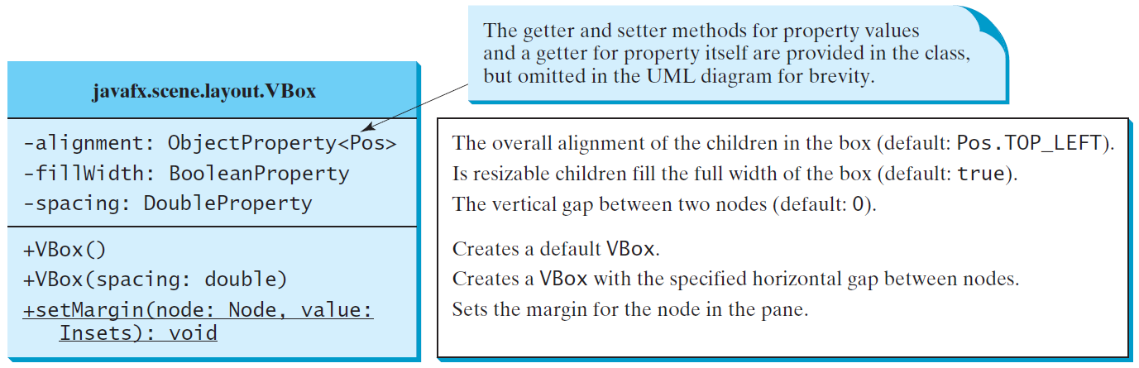
VBox
Places the nodes in a single column
ShowHBoxVBox
Run

Slide 48
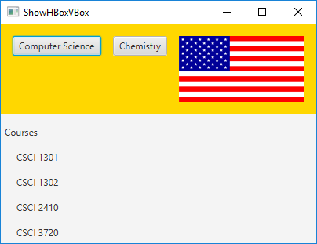
import javafx.application.Application;
import javafx.geometry.Insets;
import javafx.scene.Scene;
import javafx.scene.control.*;
import javafx.scene.layout.*;
import javafx.stage.Stage;
import javafx.scene.image.*;
public class ShowHBoxVBox extends Application {
@Override // Override the start method in the Application
public void start(Stage primaryStage) {
// Create a border pane
BorderPane pane = new BorderPane();
// Place nodes in the pane
pane.setTop(getHBox());
pane.setLeft(getVBox());
// Create a scene and place it in the stage
Scene scene = new Scene(pane);
primaryStage.setTitle("ShowHBoxVBox");
primaryStage.setScene(scene);
primaryStage.show();
}
private HBox getHBox() {
HBox hBox = new HBox(15);
hBox.setPadding(new Insets(15, 15, 15, 15));
hBox.setStyle("-fx-background-color: gold");
hBox.getChildren().add(new Button("Computer Science"));
hBox.getChildren().add(new Button("Chemistry"));
ImageView imageView = new ImageView(new Image("image/us.gif"));
hBox.getChildren().add(imageView);
return hBox;
}
private VBox getVBox() {
VBox vBox = new VBox(15);
vBox.setPadding(new Insets(15, 5, 5, 5));
vBox.getChildren().add(new Label("Courses"));
Label[] courses = {new Label("CSCI 1301"), new Label("CSCI 1302"), new Label("CSCI 2410"), new Label("CSCI 3720")};
for (Label course: courses) {
VBox.setMargin(course, new Insets(0, 0, 0, 15));
vBox.getChildren().add(course);
}
return vBox;
}
public static void main(String[] args) {
launch(args);
}
}

Slide 49
☑ Check Point
How do you add a node to a Pane, StackPane, FlowPane, GridPane, BorderPane, HBox, and VBox? How do you remove a node from these panes?
<--- ANSWER --->
To add a node to a Pane, StackPane, FlowPane, HBox, and VBox, use pane.getChildren().add(node). To add node to a BorderPane, use the setTop, setBottom, setLeft, setRight, and setCenter methods.
To remove a node from these panes, use pane.getChildren().remove(node).

Slide 50
☑ Check Point
What are the differences between a FlowPane and an HBox or a VBox?
<--- ANSWER --->
FlowPane can have multiple rows and columns. The nodes in a FlowPane can be placed horizontally or vertically.
An HBox can have only one row and an VBox can have only one column.

Slide 51
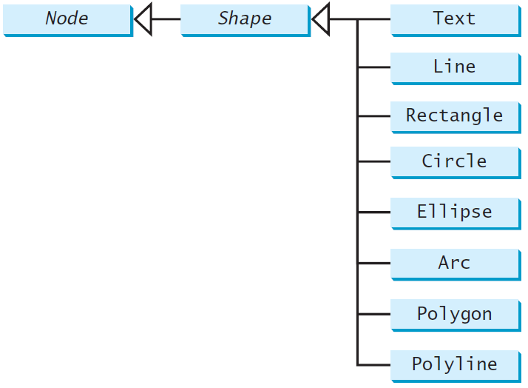
Shapes
JavaFX provides many shape classes for drawing texts, lines, circles, rectangles, ellipses, arcs, polygons, and polylines.

Slide 52
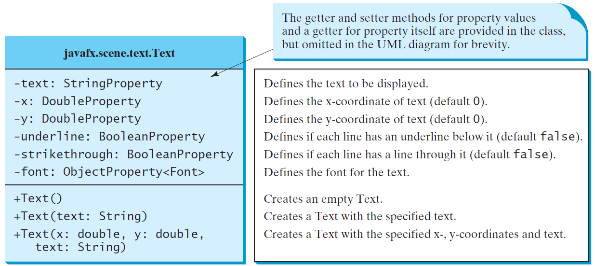
Text
Text defines a node for displaying a
text at a starting point (x, y)

Slide 53
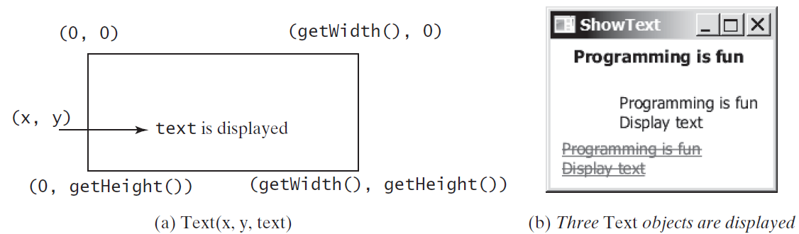
Text Example
ShowText
Run

Slide 54
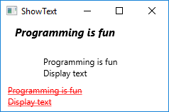
import javafx.application.Application;
import javafx.stage.Stage;
import javafx.scene.Scene;
import javafx.scene.layout.Pane;
import javafx.scene.paint.Color;
import javafx.geometry.Insets;
import javafx.scene.text.Text;
import javafx.scene.text.Font;
import javafx.scene.text.FontWeight;
import javafx.scene.text.FontPosture;
public class ShowText extends Application {
@Override
public void start(Stage primaryStage) {
Pane pane = new Pane();
pane.setPadding(new Insets(5, 5, 5, 5));
Text text1 = new Text(20, 20, "Programming is fun");
text1.setFont(Font.font("Courier", FontWeight.BOLD,
FontPosture.ITALIC, 15));
pane.getChildren().add(text1);
Text text2 = new Text(60, 60, "Programming is fun\nDisplay text");
pane.getChildren().add(text2);
Text text3 = new Text(10, 100, "Programming is fun\nDisplay
text");
text3.setFill(Color.RED);
text3.setUnderline(true);
text3.setStrikethrough(true);
pane.getChildren().add(text3);
Scene scene = new Scene(pane);
primaryStage.setTitle("ShowText");
primaryStage.setScene(scene); primaryStage.show();
}
...
}

Slide 55
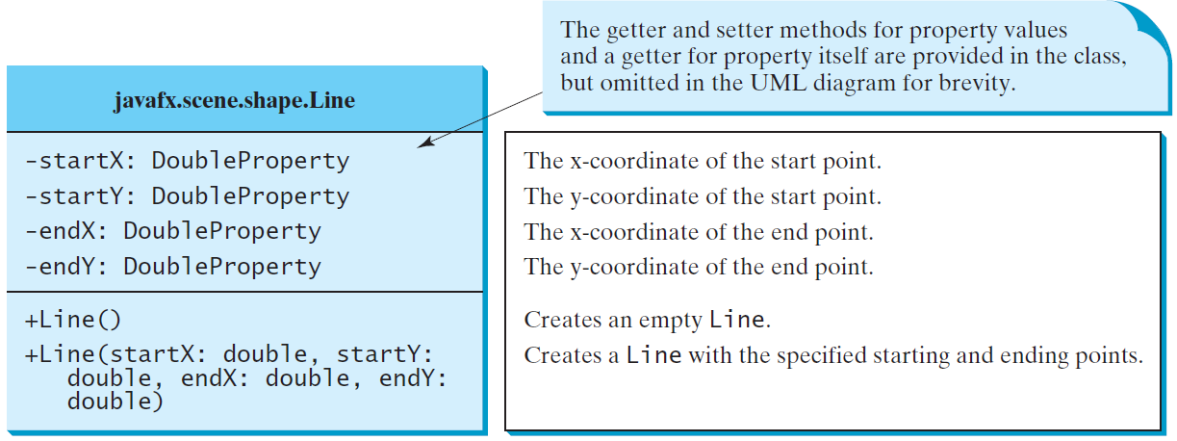
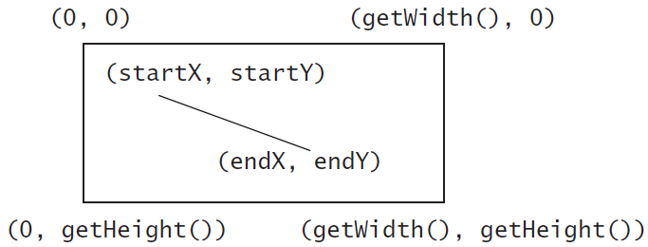
Line
A line connects two points with four
parameters startX, startY, endX, and endY.
ShowLine
Run

Slide 56
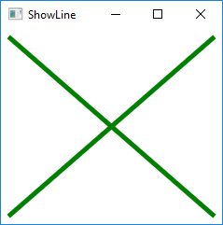
import javafx.application.Application;
import javafx.scene.Scene;
import javafx.scene.layout.Pane;
import javafx.scene.paint.Color;
import javafx.stage.Stage;
import javafx.scene.shape.Line;
public class ShowLine extends Application {
@Override // Override the start method in the Application class
public void start(Stage primaryStage) {
// Create a scene and place it in the stage
Scene scene = new Scene(new LinePane(), 200, 200);
primaryStage.setTitle("ShowLine"); // Set the stage title
primaryStage.setScene(scene); // Place the scene in the stage
primaryStage.show(); // Display the stage
}
public static void main(String[] args) {
launch(args);
}
}
class LinePane extends Pane {
public LinePane() {
Line line1 = new Line(10, 10, 10, 10);
line1.endXProperty().bind(widthProperty().subtract(10));
line1.endYProperty().bind(heightProperty().subtract(10));
line1.setStrokeWidth(5);
line1.setStroke(Color.GREEN);
getChildren().add(line1);
Line line2 = new Line(10, 10, 10, 10);
line2.startXProperty().bind(widthProperty().subtract(10));
line2.endYProperty().bind(heightProperty().subtract(10));
line2.setStrokeWidth(5);
line2.setStroke(Color.GREEN);
getChildren().add(line2);
}
}

Slide 57
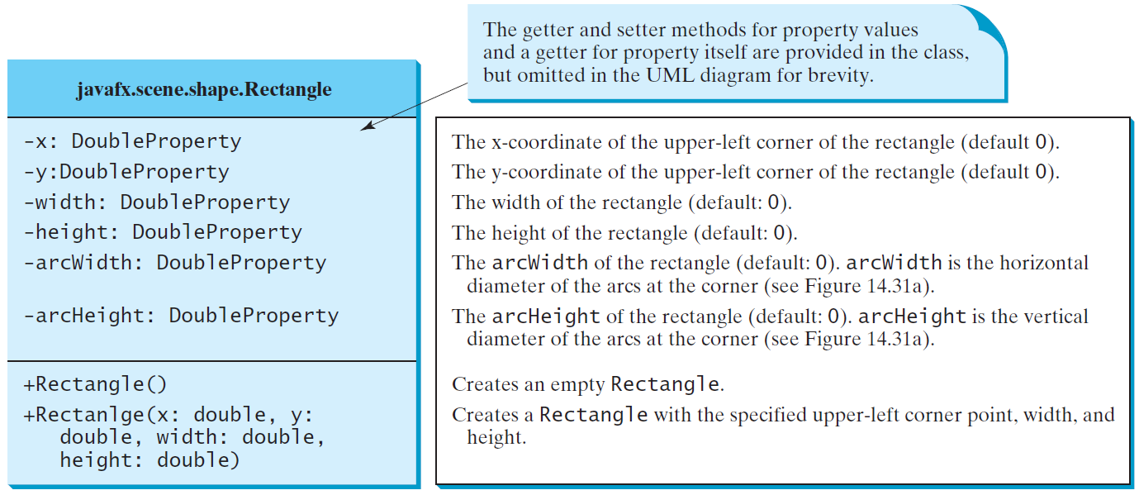
Rectangle

Slide 58
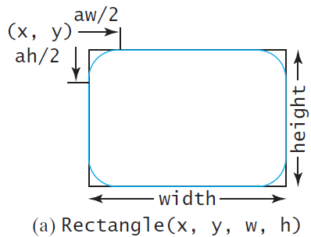
Rectangle Example
The rectangle’s upper-left
corner point is at (x, y)
aw (arcWidth) is the
horizontal diameter of the
arcs at the corner
ah (arcHeight) is the
vertical diameter of the
arcs at the corner.
ShowRectangle
Run

Slide 59
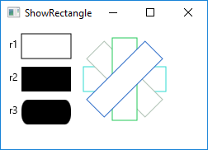
public class ShowRectangle extends Application {
@Override // Override the start method in the Application class
public void start(Stage primaryStage) {
// Create a pane
Pane pane = new Pane();
// Create rectangles and add to pane
Rectangle r1 = new Rectangle(25, 10, 60, 30);
r1.setStroke(Color.BLACK);
r1.setFill(Color.WHITE);
pane.getChildren().add(new Text(10, 27, "r1"));
pane.getChildren().add(r1);
Rectangle r2 = new Rectangle(25, 50, 60, 30);
pane.getChildren().add(new Text(10, 67, "r2"));
pane.getChildren().add(r2);
Rectangle r3 = new Rectangle(25, 90, 60, 30);
r3.setArcWidth(15);
r3.setArcHeight(25);
pane.getChildren().add(new Text(10, 107, "r3"));
pane.getChildren().add(r3);
for (int i = 0; i < 4; i++) {
Rectangle r = new Rectangle(100, 50, 100, 30);
r.setRotate(i * 360 / 8);
r.setStroke(Color.color(Math.random(), Math.random(), Math.random()));
r.setFill(Color.WHITE);
pane.getChildren().add(r);
}
// Create a scene and place it in the stage
Scene scene = new Scene(pane, 250, 150);
primaryStage.setTitle("ShowRectangle"); // Set the stage title
primaryStage.setScene(scene); // Place the scene in the stage
primaryStage.show(); // Display the stage
}
. . .
}

Slide 60
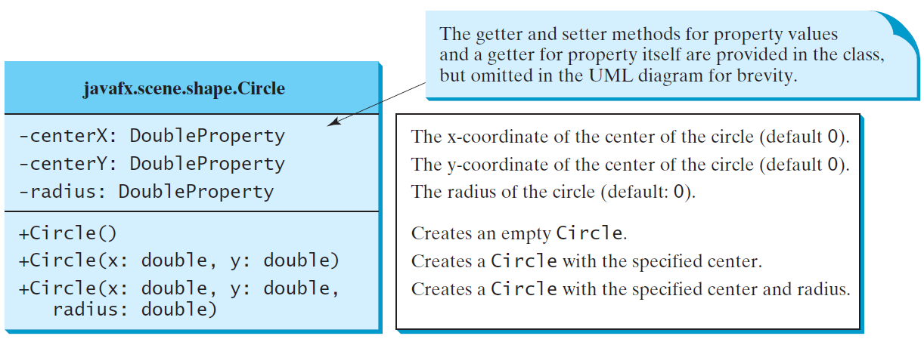
Circle

Slide 61
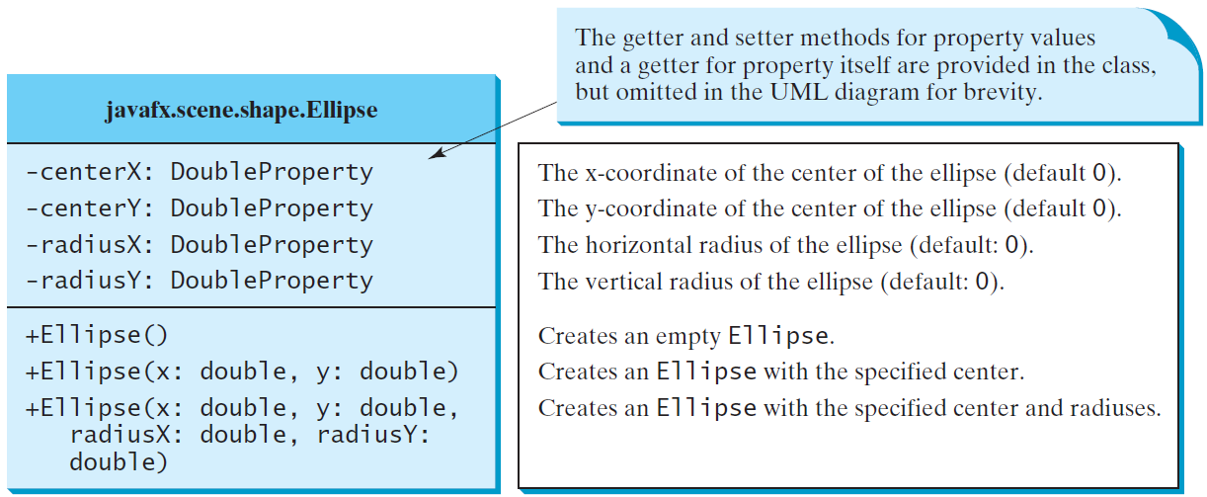
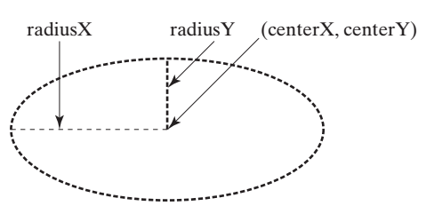
Ellipse
ShowEllipse
Run

Slide 62
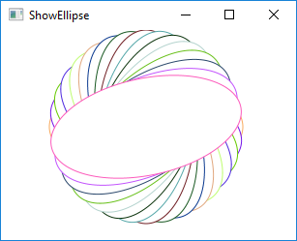
public class ShowEllipse extends Application {
@Override // Override the start method in the Application class
public void start(Stage primaryStage) {
// Create a pane
Pane pane = new Pane();
for (int i = 0; i < 16; i++) {
// Create an ellipse and add it to pane
Ellipse e1 = new Ellipse(150, 100, 100, 50);
e1.setStroke(Color.color(Math.random(), Math.random(),
Math.random()));
e1.setFill(Color.WHITE);
e1.setRotate(i * 180 / 16);
pane.getChildren().add(e1);
}
// Create a scene and place it in the stage
Scene scene = new Scene(pane, 300, 200);
primaryStage.setTitle("ShowEllipse"); // Set the stage title
primaryStage.setScene(scene); // Place the scene in the stage
primaryStage.show(); // Display the stage
}
/**
* The main method is only needed for the IDE with limited
* JavaFX support. Not needed for running from the command line.
*/
public static void main(String[] args) {
launch(args);
}
}

Slide 63
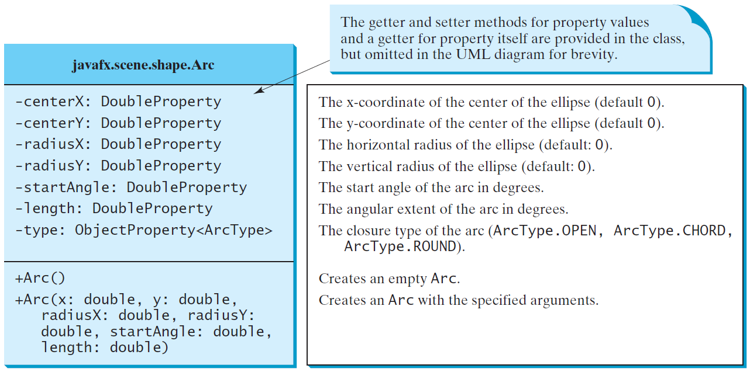
Arc

Slide 64
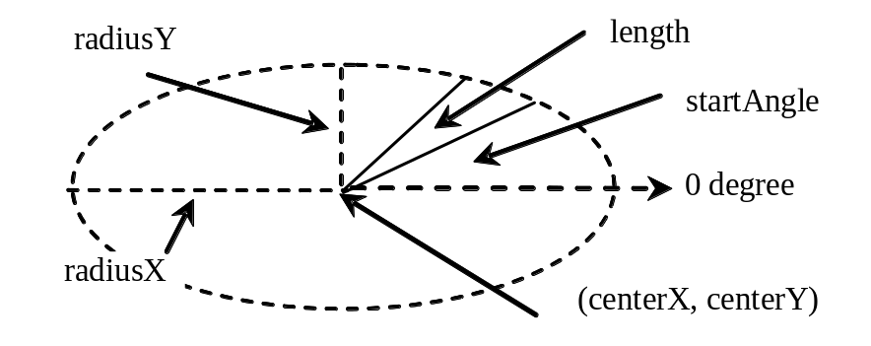
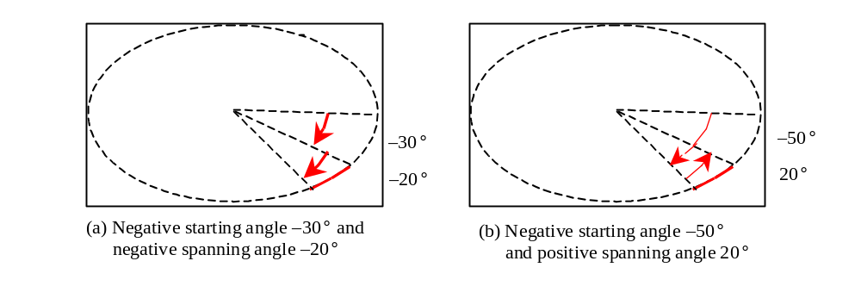
Arc Examples
ShowArc
Run

Slide 65
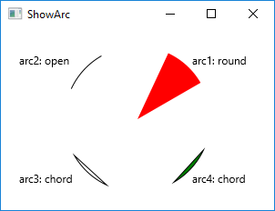
public class ShowArc extends Application {
@Override // Override the start method in the Application class
public void start(Stage primaryStage) {
// Create a pane
Pane pane = new Pane();
Arc arc1 = new Arc(150, 100, 80, 80, 30, 35); // Create an arc
arc1.setFill(Color.RED); // Set fill color
arc1.setType(ArcType.ROUND); // Set arc type
pane.getChildren().add(new Text(210, 40, "arc1: round"));
pane.getChildren().add(arc1); // Add arc to pane
Arc arc2 = new Arc(150, 100, 80, 80, 30 + 90, 35);
arc2.setFill(Color.WHITE);
arc2.setType(ArcType.OPEN);
arc2.setStroke(Color.BLACK);
pane.getChildren().add(new Text(20, 40, "arc2: open"));
pane.getChildren().add(arc2);
Arc arc3 = new Arc(150, 100, 80, 80, 30 + 180, 35);
arc3.setFill(Color.WHITE);
arc3.setType(ArcType.CHORD);
arc3.setStroke(Color.BLACK);
pane.getChildren().add(new Text(20, 170, "arc3: chord"));
pane.getChildren().add(arc3);
Arc arc4 = new Arc(150, 100, 80, 80, 30 + 270, 35);
arc4.setFill(Color.GREEN);
arc4.setType(ArcType.CHORD);
arc4.setStroke(Color.BLACK);
pane.getChildren().add(new Text(210, 170, "arc4: chord"));
pane.getChildren().add(arc4);
// Create a scene and place it in the stage
Scene scene = new Scene(pane, 300, 200);
primaryStage.setTitle("ShowArc"); // Set the stage title
primaryStage.setScene(scene); // Place the scene in the stage
primaryStage.show(); // Display the stage
}
…
}

Slide 66
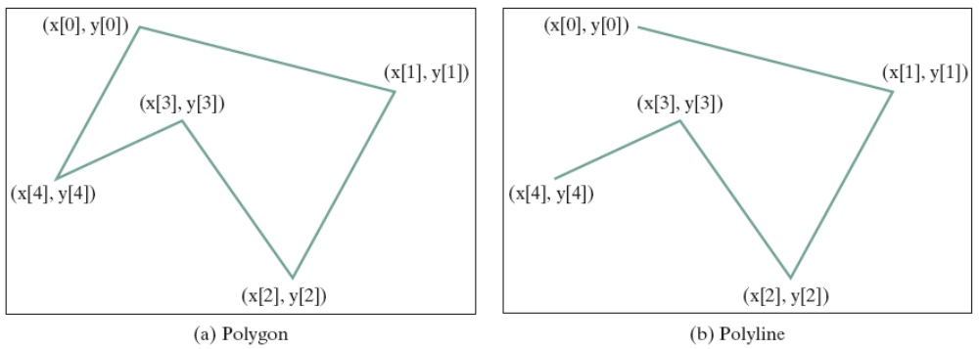
Polygon and Polyline
The Polygon class defines a polygon that connects a sequence of points.
The Polyline class is similar to the Polygon class except that the Polyline class is not automatically closed.

Slide 67
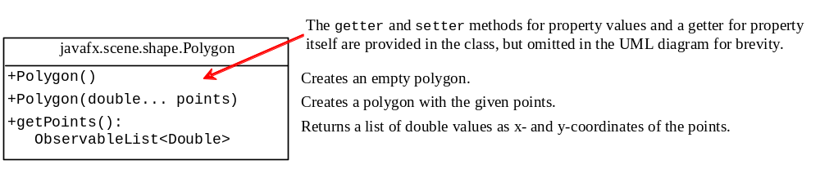
Polygon
ShowPolygon
Run

Slide 68
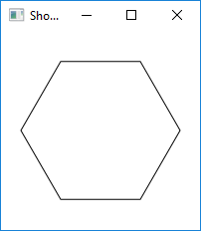
import javafx.application.Application;
import javafx.collections.ObservableList;
import javafx.scene.Scene;
import javafx.scene.layout.Pane;
import javafx.scene.paint.Color;
import javafx.stage.Stage;
import javafx.scene.shape.Polygon;
public class ShowPolygon extends Application {
@Override // Override the start method in the Application class
public void start(Stage primaryStage) {
// Create a pane, a polygon, and place polygon to pane
Pane pane = new Pane();
Polygon polygon = new Polygon();
pane.getChildren().add(polygon);
polygon.setFill(Color.WHITE);
polygon.setStroke(Color.BLACK);
ObservableList<Double> list = polygon.getPoints();
final double WIDTH = 200, HEIGHT = 200;
double centerX = WIDTH / 2, centerY = HEIGHT / 2;
double radius = Math.min(WIDTH, HEIGHT) * 0.4;
// Add points to the polygon list
for (int i = 0; i < 6; i++) {
list.add(centerX + radius * Math.cos(2 * i * Math.PI / 6));
list.add(centerY - radius * Math.sin(2 * i * Math.PI / 6));
}
// Create a scene and place it in the stage
Scene scene = new Scene(pane, WIDTH, HEIGHT);
primaryStage.setTitle("ShowPolygon"); // Set the stage title
primaryStage.setScene(scene); // Place the scene in the stage
primaryStage.show(); // Display the stage
}
. . .
}

Slide 69
☑ Check Point
Write code fragments to display the outline of the upper half of a circle with radius 50.
<--- ANSWER --->
Arc arc = new Arc();
arc.setRadiusX(50); arc.setRadiusY(50);
arc.setFill(null);
arc.setStartAngle(0); arc.setLength(180);
arc.setType(ArcType.OPEN);

Slide 70
☑ Check Point
Write code fragments to display the lower half of a circle with radius 50 filled with the red color.
<--- ANSWER --->
Arc arc = new Arc();
arc.setRadiusX(50); arc.setRadiusY(50);
arc.setStartAngle(180); arc.setLength(180);
arc.setFill(Color.RED);
arc.setType(ArcType.ROUND);

Slide 71
☑ Check Point
What is wrong in the following code?
public void start(Stage primaryStage) {
// Create a polygon and place it in the scene
Scene scene = new Scene(new Polygon(), 400, 400);
primaryStage.setScene(scene); // Place the scene in the stage
primaryStage.show(); // Display the stage
}
<--- ANSWER --->
Polygon is a Shape, which cannot be directly added to a scene.
You have to place a shape into a pane and add the pane into the scene.

Slide 72
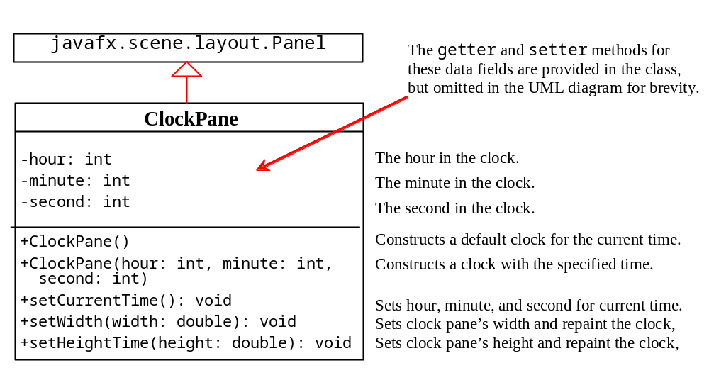
Case Study: The ClockPane Class
This case study develops a class that displays a clock on a pane.
ClockPane

Slide 73


Use the ClockPane Class
(a) The DisplayClock program displays a clock that shows the current time.
(b) The endpoint of a clock hand can be determined, given the spanning angle, the hand length, and the center point.
endX = centerX + handLength × sin(θ)
endY = centerY - handLength × cos(θ)
DisplayClock
Run

Slide 74
Use the ClockPane Class (cont.)
Since there are 60 seconds in one minute, the angle for the second hand is:
  θ = second × (2π/60)
Since there are 60 minutes in one hour, the angle for the minute hand is:
  θ = minute × (2π/60)
Since one circle is divided into 12 hours, the angle for the hour hand is:
  θ = (hour + minute/60) × (2π/12)

